Slide 1
Face detection in Go and Webassembly
(using the Pigo library)
Endre Simo

Slide 2

What is Pigo?
https://github.com/esimov/pigo

Slide 3
What is Pigo?
- Computer vision library for face detection, pupils/eyes localization and facial landmark points detection
- The only face detection library in the Go ecosystem developed 100% in Go

Slide 4
Why it has been developed?
- All of the existing face detection libraries developed in Go are actually bindings (wrappers) around some C/C++ libraries
- Bindings (using the cgo) most of the times are not cost effective
- Compiling a C library to Go results in slower build times

Slide 5
Why it has been developed?
- The desire of a single binary file is just a desire
- Installing OpenCV sometimes can be daunting
- OpenCV is huge, impossible to deploy it on small platforms where space constraints are important

Slide 6
What are the benefits of using Pigo?
- Very lightweight, no requirements for 3rd party modules and external libraries
- Platform independent, one single executable
- High processing speed
- No need for image preprocessing prior detection
- Simple and elegant API
- CLI application bundled into the library

Slide 7
What are the benefits of using Pigo?
- Fast detection of in-plane rotated faces
- Pupils/eyes localization
- Facial landmark points detection
- WASM (Webassembly) support

Slide 8
Technical overview
- Pigo is constructed around cascade decision trees, but the cascade classifier is in binary format
- The role of a classifier is to tell if a face is present in the current region or not
- The classifier consists of a decision tree, where the results of pixel intensity comparison test are in binary format.

Slide 9
Unpacking the cascade files
- Because the cascades are encoded into a binary tree structure they first need to be unpacked.
- The unpacking method will return in the following struct:
return &Pigo{
treeDepth,
treeNum,
treeCodes,
treePred,
treeThreshold,
}, nil

Slide 10
Regions classification
- We classify the regions based on the parsed binary data
- The classification is based on pixel intensity comparison test encoded in binary format
bintest := func(px1, px2 uint8) int {
if px1 <= px2 {
return 1
}
return 0
}
idx = 2*idx + bintest(pixels[x1], pixels[x2])

Slide 11
Run the cascades
- An image region is considered being face if it passes all the cascade members.
- During the decision tree scanning each detection is flagged with a detection score.
- An image region is considered as face if the detection score is above a certain threshold (~0.995)

Slide 12
Run the cascades
// Detection struct contains the detection results composed of
// the row, column, scale factor and the detection score.
type Detection struct {
Row int
Col int
Scale int
Q float32
}

Slide 13
Cluster detection
- Due to the noisiness of the underlying pixel data, the detector might produce overlaps in detections.

Slide 14
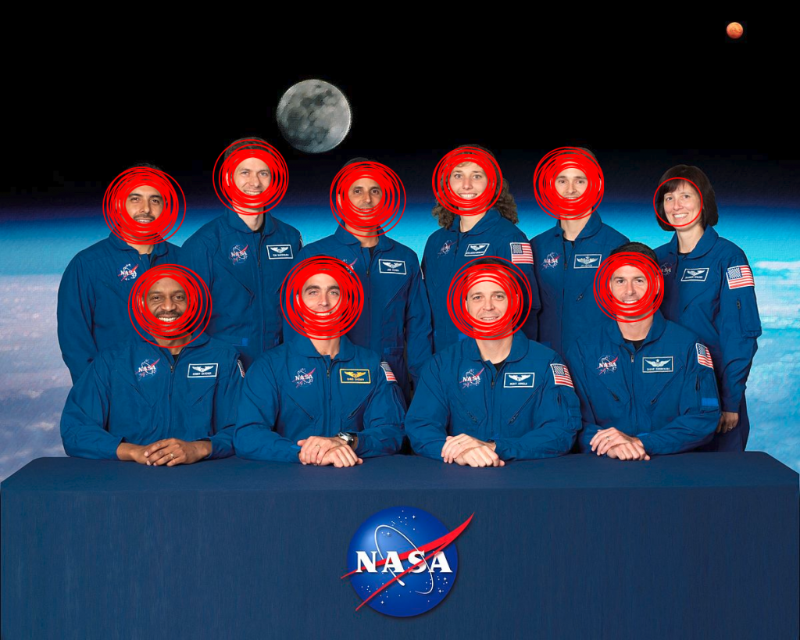
Cluster detection

Slide 15
Cluster detection
- The cascade regions are clustered together by applying an IoU (Intersection over Union) formula over the detection results.

Slide 16

Detection result

Slide 17
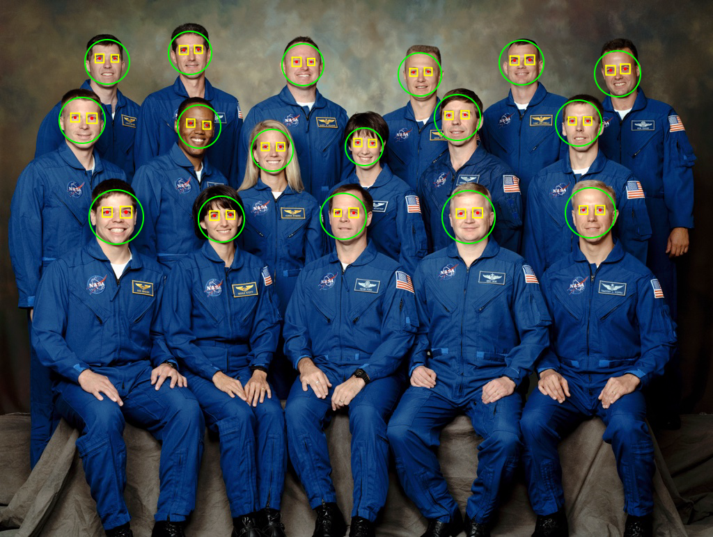
Pupils/eyes localization

Slide 18
Short overview
- The implementation resembles with the face detection method
- The output of the regression trees might be noisy
- Random perturbation factor to outweigh the false positive rates on detection

Slide 19
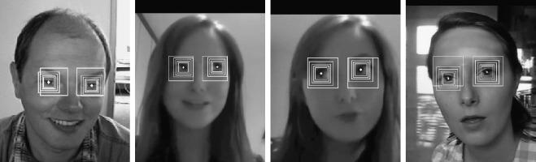
Pupils/eyes localization

Slide 20
Short overview
- The detection function is almost identical for the left and right eye.
// left eye
puploc = &pigo.Puploc{
Row: face.Row - int(0.075*float32(face.Scale)),
Col: face.Col - int(0.175*float32(face.Scale)),
Scale: float32(face.Scale) * 0.25,
Perturbs: perturb,
}
// right eye
puploc = &pigo.Puploc{
Row: face.Row - int(0.075*float32(face.Scale)),
Col: face.Col + int(0.185*float32(face.Scale)),
Scale: float32(face.Scale) * 0.25,
Perturbs: perturb,
}

Slide 21
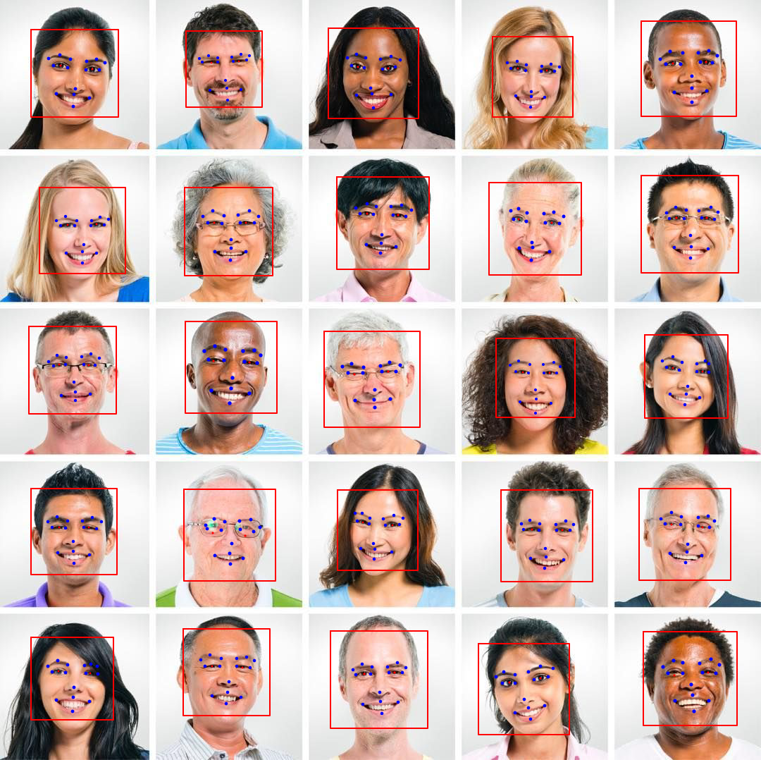
Facial landmark points detection

Slide 22
Landmark points detection
- The landmark points are detected based on the results returned by the pupil localization function

Slide 23
Compute the landmark points
This can be achieved by:
1.) flipping the sign of the column coordinate in tree nodes
2.) flipping the sign in the column coordinate for each binary test

Slide 24
Use cases and integrations
- OpenFaaS integration
https://github.com/esimov/pigo-openfaas
https://github.com/esimov/pigo-openfaas-faceblur
- Avoiding face deformation in Caire (https://github.com/esimov/caire)

Slide 25
Pigo as a shared library
- Go is missing a well founded and generally available webcam library
- Transfer the Go face detection results to Python as a shared object library (.so)

Slide 26
Interoperability between Go and Python trough cgo
- In Python the Ctype library is used to interoperate with the Go code through cgo
- It provides C compatible data types, and allows calling functions in DLLs or shared libraries.

Slide 27
Interoperability between Go and Python trough cgo
Limitations:
- In Go is not possible transfer a 2D array as an array pointer.
- The trick is to convert the 2D array to a 1D array.
delimit each detection group
introduce as a first slice element the number of detected faces
- Using the numpy library we transform the 1D array to the desired shape (normally to a multidimensional array with x, y, dim) .
- In the end we should obtain something like below:
[2 0 0 0 0 272 297 213 41 1 248 258 27 41 0 248 341 27 41 0 238 599 72 25 1 230 587 9 25 0 233 616 9 25 0]

Slide 28
Interoperability between Go and Python trough cgo
go func() {
// Since in Go we cannot transfer a 2d array through an array pointer
// we have to transform it into 1d array.
for _, v := range result {
det = append(det, v...)
}
// Include as a first slice element the number of detected faces.
// We need to transfer this value in order to define the Python array buffer length.
det = append([]int{len(result), 0, 0}, det...)
// Convert the slice into an array pointer.
s := *(*[]uint8)(unsafe.Pointer(&det))
p := uintptr(unsafe.Pointer(&s[0]))
// Ensure `det` is not freed up by GC prematurely.
runtime.KeepAlive(det)
// return the pointer address
pointCh <- p
}()
return <-pointCh

Slide 29
Interoperability between Go and Python trough cgo
Caveats:
- The cost using cgo can be substantial
- C and Go exists in two different universe, they interoperate through cgo. This is not costs effective.
- The C compiler has to be invoked for every C file in the package.
- Slower build times
- Ctype introduce another latency factor

Slide 30
Porting Pigo to Webassembly (WASM)
- Running Pigo as shared object does not proved the library pure performance in terms of real time capabilities
- Webassembly is a binary instruction format targeting the web browsers which brings almost native like performance
- Many low level languages are already offer support for WASM (C, C++, Rust, Go etc.)
- More and more projects are getting ported to WASM
- Go already offer good Webassembly support through the syscall/js package
- The API has gone through some refactorings and improvements to be stable starting from v1.13

Slide 31
Building
$ GOOS=js GOARCH=wasm go build -o lib.wasm wasm.go
Build constraints:
// +build js,wasm*

Slide 32
Porting Pigo to Webassembly (WASM)
- Running Pigo as shared object does not proved the library pure performance in terms of real time detection
- Webassembly is a binary instruction format targeting the web browsers which brings almost native like performance
- Many low level languages are already offer support for WASM (C, C++, Rust, Go etc.)
- More and more projects are getting ported to WASM
- Go already offer good Webassembly support through the syscall/js package
- The API has gone through some refactorings and improvements to be stable starting from v1.13

Slide 33
WASM integration
- The generated wasm file can be referenced in the main html file.
- Incompatibilities between Go versions
- Different Go versions have different wasm_exec.js file
- Copy the wasm_exec.js file from $GOROOT on the fly.

Slide 34
WASM integration
wasm:
cp -f "$$(go env GOROOT)/misc/wasm/wasm_exec.js" ./js/
GOOS=js GOARCH=wasm go build -o lib.wasm wasm.go

Slide 35
WASM integration
- The WASM file can be referenced in the main html file.
<script type="text/javascript">
function fetchAndInstantiate(url, importObject) {
return fetch(url).then(response =>
response.arrayBuffer()
).then(bytes =>
WebAssembly.instantiate(bytes, importObject)
).then(results =>
results.instance
);
}
var go = new Go();
var mod = fetchAndInstantiate("lib.wasm", go.importObject);
window.onload = function () {
mod.then(function (instance) {
go.run(instance);
});
};
</script>

Slide 36
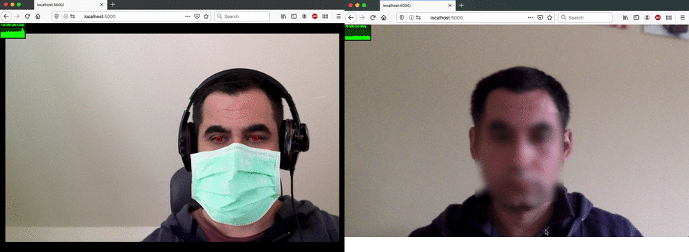
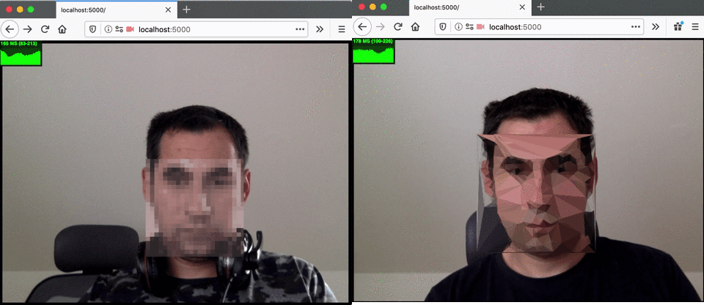
DEMO

Slide 37
What’s next?
Features detection and matching (to detect similarities between and inside images)
Evolve Pigo into a fully featured Computer Vision and Machine Learning library

Slide 38
Endre Simo
@simo_endre
github.com/esimov
esimov.com

